Slide 1
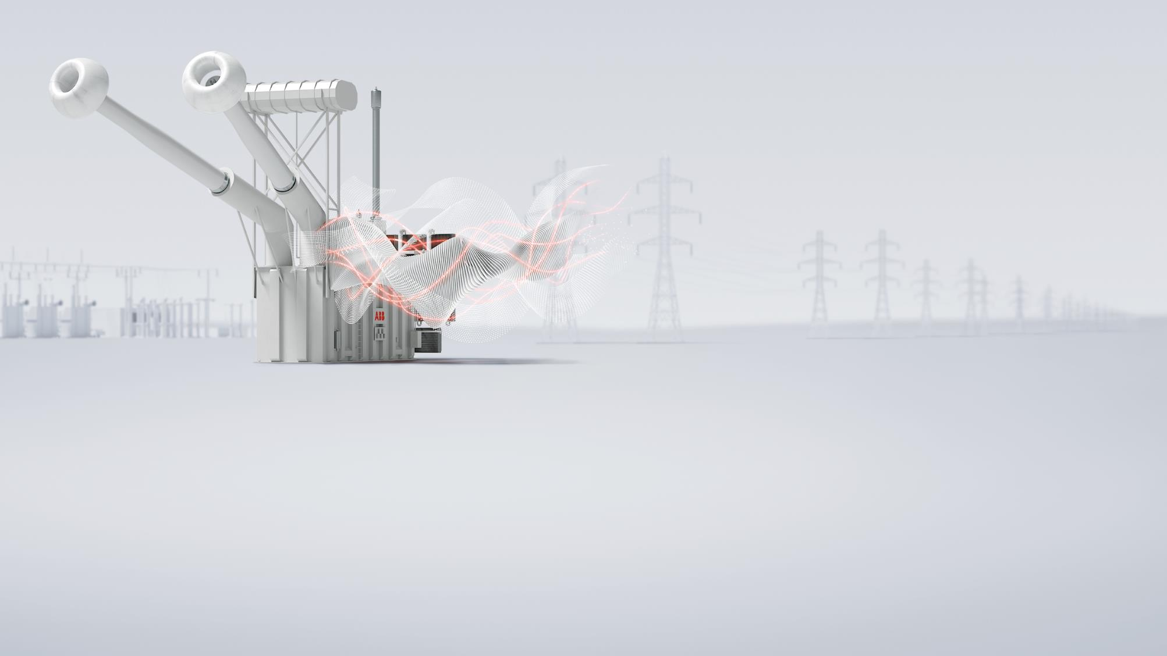
What are the current best practices in designing, implementing, and evolving our defenses and responses?
ABB Grid automation, Steven Kunsman, March 21, 2018
Energy Policy Roundtable in the PJM Footprint
Emerging Industry Best Practices on Cybersecurity in the Utility Industry Panel Session

Slide 2
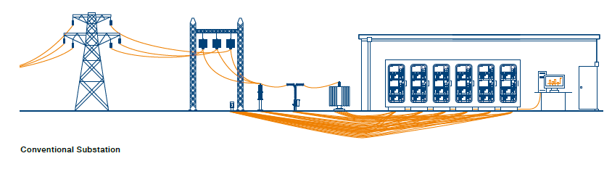
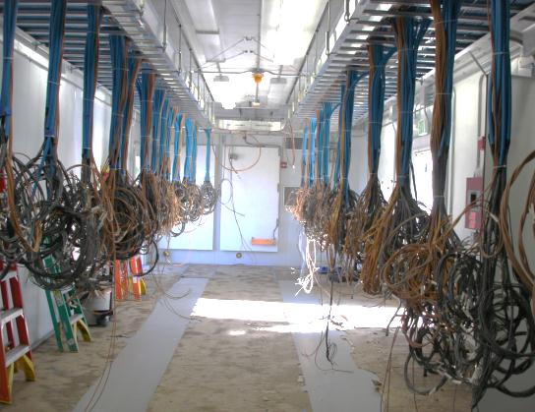
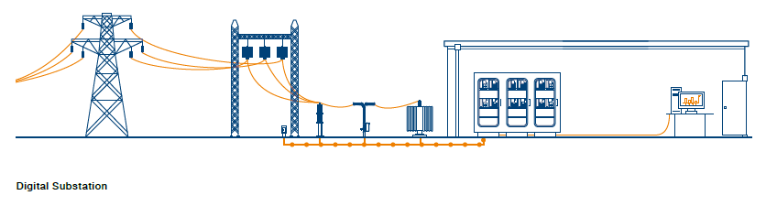
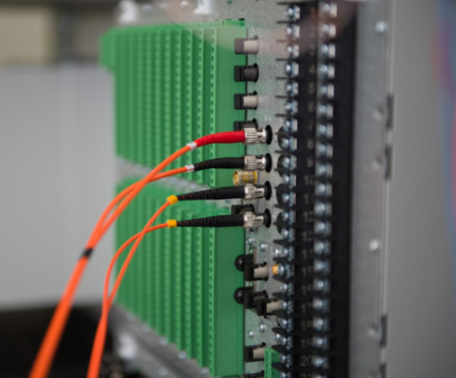
Why Digitalize Substations?
Replacing 1000’s copper wires with a few communications fiber
Digitalization Benefits
Improved safety
Improved reliability
Improved resiliency
Reduced CAPEX
Reduced OPEX
Reduced footprint
Information availability
System self-supervised
Ethernet in the switchyard
Risk or benefit?

Slide 3
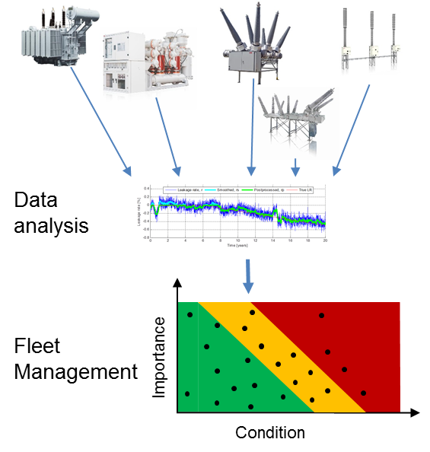
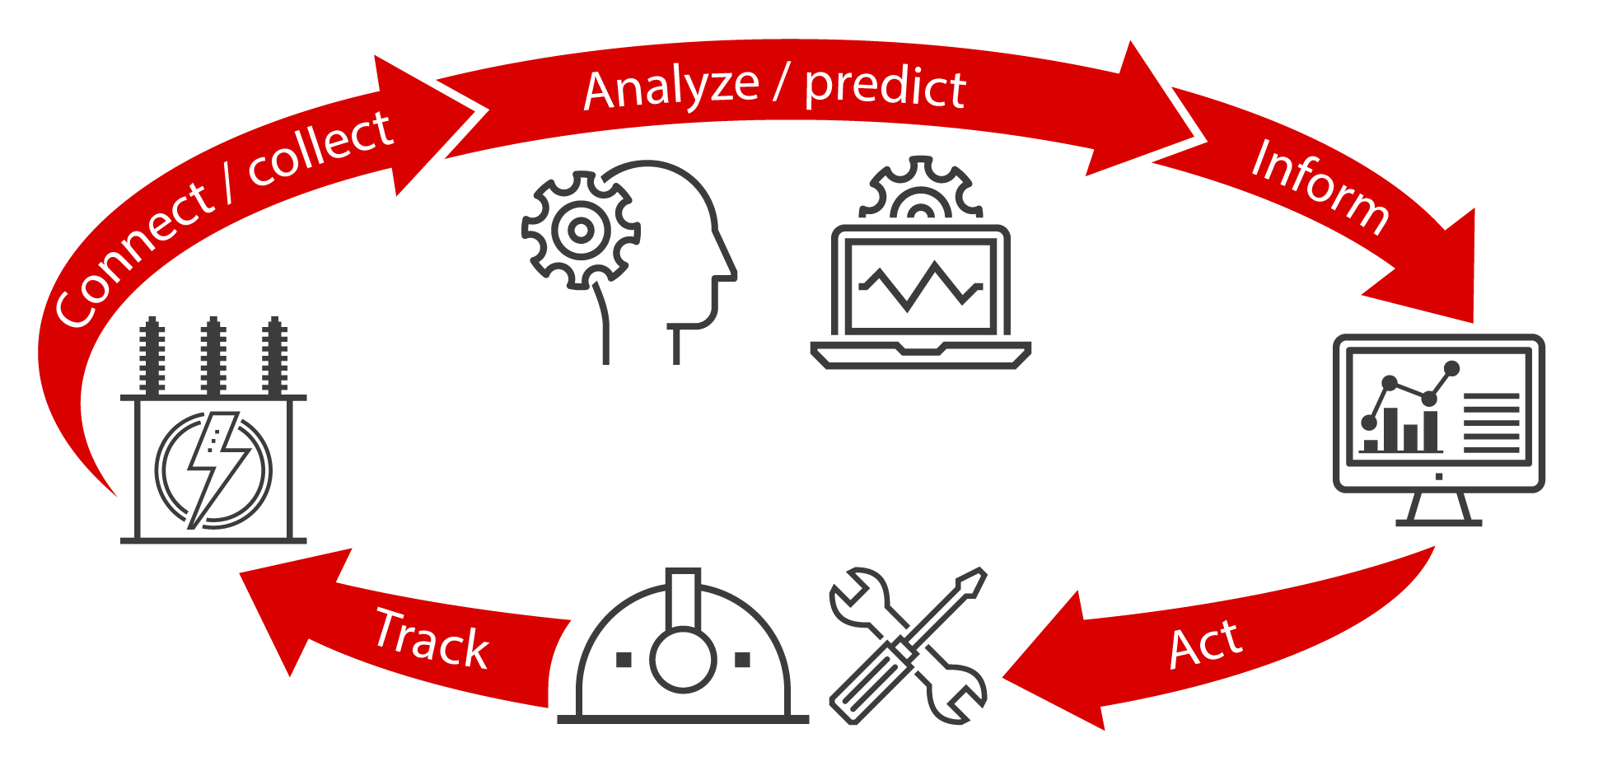
Digitalization Enables Asset Performance Management
Real time information flow for continuous risk-based optimization
Expert models
Statistical models
Continuous optimization and improvement
Advanced operational business intelligence
Enterprise asset and work management

Slide 4
Business Challenge: The Ultimate Goal
Balancing Reliability and Cybersecurity
Critical Infrastructure Protection (CIP)
Power System Reliability
Reliability
Cybersecurity
Digitalization
Infrastructure
Safe & Secure delivery of Reliable Power
Air gap is not a solution
Information flow critical for today / tomorrow’s successful grid management
Let’s not forget: The “R” in NERC stands for Reliability!

Slide 5
Cultural Challenge: Enterprise IT vs. Control Systems OT
A different set of challenges – Education, Awareness and Teamwork
 | Enterprise IT | Control Systems OT
Primary object under protection | Information | Physical process
Primary risk impact | Information disclosure, financial | Safety, health, environment, financial
Main security objective | Confidentiality | Availability
Security focus | Central Servers (fast CPU, lots of memory, …) | Distributed System (possibly limited resources)
Availability requirements | 95 – 99% (accept. downtime/year: 18.25 - 3.65 days) | 99.9 – 99.999% (accept. downtime/year: 8.76 hrs – 5.25 minutes)
Problem response | Reboot, patching/upgrade, isolation | Fault tolerance, online repair

Slide 6



Growing Cybersecurity Threats
Maintenance
Center
Network Control
Center
Network disturbance, malware, Cyber attacks
Unauthorized access and attacks
Attacks on utilities
Ukraine I – Dec 2015 (Sandworm)
Spear phishing, BlackEnergy, KillDisk
Ukraine II – Dec 2016 (Electrum)
Industroyer/CrashOverride
Challenge: Information Sharing
Incident response / forensics
Collaboration between agencies, utilities and manufacturers essential
Computer
HMI
GPS
Time Server
Engineering
Workstation
Router
Firewall
VPN
Gateway
SYS600C
SYS600C
Unauthorized
Person
Station LAN
Data storm by a
Faulty Device
Infected
Mobile
data
storage
USB
IEC 61850 / Station bus
Infected
Notebook
Electronic Security perimeter
Unauthorized
Person
Physical Security perimeter
E-ISAC-SANS Report on Ukraine I
E-ISAC-SANS Report on Ukraine II

Slide 7
Understanding cybersecurity standards and regulations
The most relevant technical standards
  NISTIR 7628 - Smart Grid Cyber Security Strategy and Requirements
  IEEE C37.240 - Cybersecurity Requirements for Power System Automation, Protection and Control Systems
  IEEE 1686 - Standard for Intelligent Electronic Devices (IEDs)Cybersecurity Capabilities
  IEEE 1711.2 - Trial-Use Standard for Secure SCADA Communications Protocol (SSCP)
  IEC 62351 – Power systems management and associated information exchange - Data and communication security
  NERC CIP – Security regulation for North American power utilities
  ISO/IEC 27001 – information security management processes
  ISA S99/IEC 62443 – Industrial Automation and Control System Security
  Critical Infrastructure Cyber Community (aka “C Cubed”) Voluntary Program – based on Executive Order (EO) 13636: Improving Critical Infrastructure Cybersecurity and released Presidential Policy Directive (PPD)-21: Critical Infrastructure Security and Resilience
https://www.dhs.gov/ccubedvp
Notes:
7

Slide 8
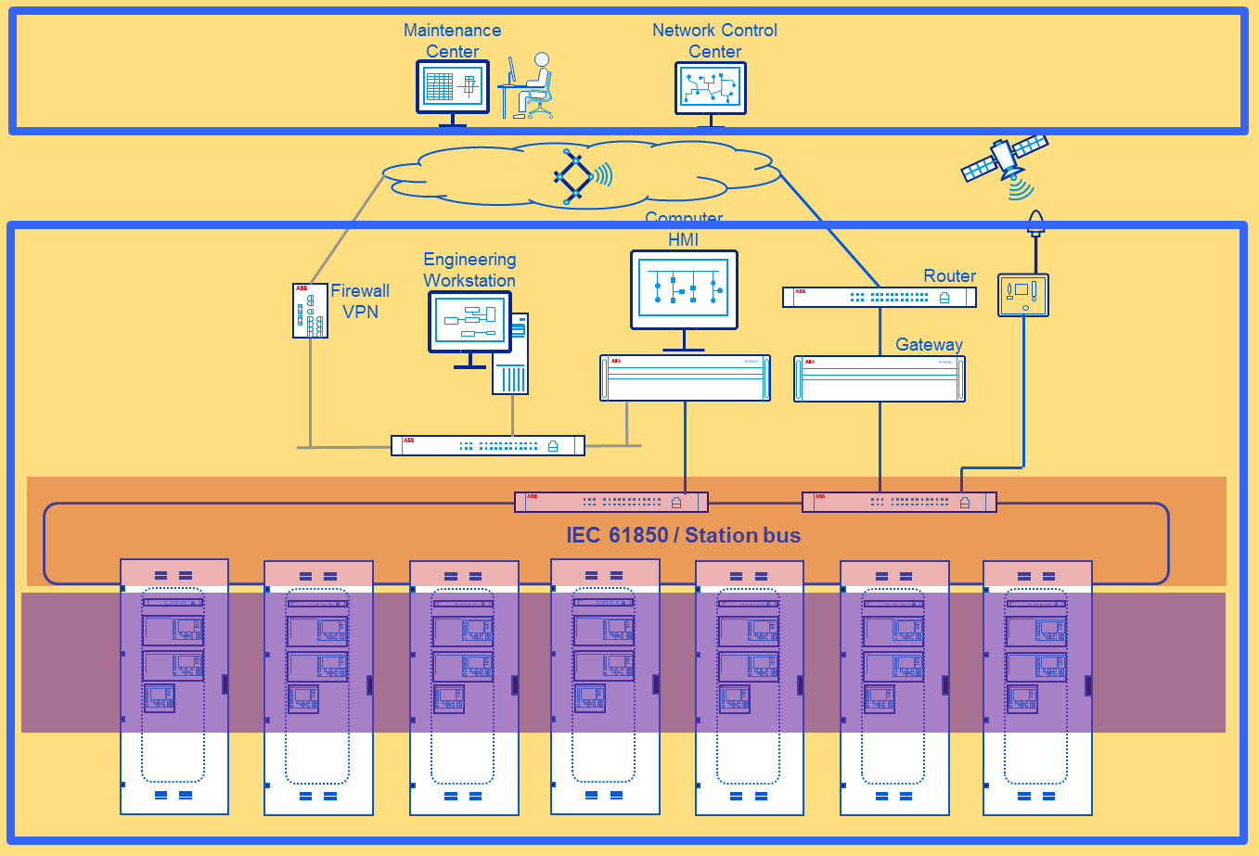

Applicability of cybersecurity standards and regulations
Building Cybersecurity Defense-in-Depth
IEEE C37.240
IEC 62443
NERC CIP
IEEE 1711.2
IEC 62351
IEEE 1686

Slide 9
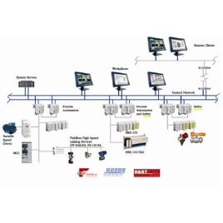

Improving cybersecurity posture
Holistic and collaborative approach
Cybersecurity is an integral part of every:
  Product lifecycle from early design and development, validation to maintenance and support services
  Project lifecycle ensuring delivery of solutions with the appropriate security measures as well as secure execution including in sensitive project information
  System/Solution lifecycle supporting efforts to operate and maintain solutions’ security including vulnerability response and patch management
Vendor-Utility-Government strong collaborations:
  Working closely on awareness “Replacing Fear with Knowledge”
  Partnerships with government organizations, industry partners and academia
  Actively engaging industry standards e.g. IEEE 1686 & IEEE C37.240
  Incident response information sharing and expert engagement
Cybersecurity must be “baked in” not “bolted on”!

Slide 10
IEEE PES Power Systems Communication and Cybersecurity (PSCC)
Cybersecurity Subcommittee (S0) Scope – Newly formed in 2017
Studying and reviewing engineering (including information technology and operation technology), operational, and testing aspects of cybersecurity related to the Electric Power System.
  Scope includes IEEE cyber security for the entire electric power system
Developing and maintaining related standards, recommended practices and guides for such aspects
Coordinating with other technical committees, groups, societies and associations as required
Preparing and arranging for publication technical reports related to the Subcommittee’s scope
Subcommittee Officers
Chair: Steven Kunsman
Vice-chair: James Bougie
Secretary: Farel Becker
For additional information contact: steven.a.kunsman@us.abb.com
Webpage: http://sites.ieee.org/pes-pscc/cybersecurity-subcommittee-s0/

Slide 11
IEEE PSCC CYBERSECURITY SUBCOMMITTEE
S0 Subcommittee Standard and Task Force Activity
WG S1: IEEE 1686 Standard for Intelligent Electronic Devices Cybersecurity Capabilities
WG S2: IEEE P1711.1 Serial SCADA Protection Protocol (SSPP)
WG S3: IEEE P2030.102.1 Standard for Interoperability of IPSEC Utilized within Utility Control Systems
WG S4: IEEE P1711.2 Trial-Use Standard for Secure SCADA Communications Protocol (SSCP)
WG S5: IEEE C37.240 Cybersecurity Requirements for Power System Automation, Protection and Control Systems
TF S6: IoT for connected home - communication and cybersecurity requirements
TF S7: Electrical Power System Cyber Device Function Numbers, Acronyms, and Designations
TF S8: Testing Power System Cybersecurity Controls

Slide 12
IEEE PSCC CYBERSECURITY SUBCOMMITTEE
S0 Study Group Activity for May 2018 Meeting
SG S9: Utility IT-OT Cybersecurity challenges in roles and terminology A core theme from the IEEE Cybersecurity workshop was the utility need for IT and OT collaboration to address cybersecurity differences (culture, application, perspective and terminology) Assess the IT-OT challenge in Utility Cybersecurity roles and create a report to assist in building organizational understanding and collaboration
SG S10: Utility & municipality challenges on understanding cybersecurity standards Assess the challenge in utilities & municipalities with limited resources on the applicability and relevance of the cybersecurity standards and create a report to assist summarizing the relevant cybersecurity standards

Slide 14

Steven A. Kunsman
steven.a.kunsman@us.abb.com
Director of Product Management and Applications
ABB Power Grids
Grid Automation, North America
Steve joined ABB Inc. in 1984 and has over 34 years of experience in substation automation, protection and control. He is a graduate of Lafayette College with a BS in electrical engineering and Lehigh University with an MBA concentrated in management of technology. Steve holds 5 patents in the protection and control application area.
Industry Involvement
  IEEE Senior Member
  IEEE PES PSCC Cybersecurity Subcommittee Chairperson
  UCA International User Group Executive committee co-chairperson
  IEC TC57 WG10 member developing IEC 61850
  Member of CIGRE US National Committee

Slide 15
IEEE PSCC CYBERSECURITY SUBCOMMITTEE
S0 Standard Activity
WG S1: 1686 Standard for Intelligent Electronic Devices Cybersecurity Capabilities Scope: The standard defines the functions and features to be provided in intelligent electronic devices (IEDs) to accommodate cybersecurity programs. The standard addresses security regarding the access, operation, configuration, firmware revision and data retrieval from an IED. Confidentiality, integrity and availability of external interfaces of the IED is also addressed. Status: PAR was approved and the WG started the revision of IEEE 1686.
WG S2: P1711.1 Serial SCADA Protection Protocol (SSPP) Scope: This standard defines the Substation Serial Protection Protocol (SSPP), a cryptographic protocol to provide integrity, and optional confidentiality, for cyber security of substation serial links. It does not address specific applications or hardware implementations, and is independent of the underlying communications protocol. Status: Draft standard is being finalized and proceed to MEC review. WG vote and proceed to ballot. Proceeding to ballot resolution. WG PAR was extended to Dec 2018.
WG S3: P2030.102.1 Standard for Interoperability of IPSEC Utilized within Utility Control Systems Scope: This standard specifies requirements for interoperability of devices utilized within utility control systems which implement the Internet Protocol Security (IPsec) protocol suite within an IPv4 environment. Status: Group reviewing open comments. WG PAR was extended to Dec 2018.
WG S4: P1711.2 Trial-Use Standard for Secure SCADA Communications Protocol (SSCP) Scope: This trial use standard defines a cryptographic protocol to provide integrity with optional confidentiality for cyber security of substation serial links. It does not address specific applications or hardware implementations and is independent of the underlying communications protocol. Status: Draft standard is being finalized to proceed for MEC review. WG PAR was extended to Dec 2018.

Slide 16
IEEE PSCC CYBERSECURITY SUBCOMMITTEE
S0 Standard/Task Force Activity
WG S5: C37.240 Cybersecurity Requirements for Power System Automation, Protection and Control Systems Scope: Revision of IEEE C37.240 to included new technical requirements for power system cyber security. Based on sound engineering practices, requirements can be applied to achieve high levels of cyber security of automation, protection and control systems independent of voltage level or criticality of cyber assets. Status: WG PAR was approved allowing the group to commence. The identified gaps were discussed and assignments made to begin drafting work.
TF S6: IoT for connected home - Communication and cybersecurity requirements Scope: To produce a report that describes the different use cases that make use of the Connected Homes concept, presents a security risk analysis and propose requirements for telecommunication (Volume, frequency, speed) and cybersecurity. Guidelines for utilities experts will be listed. Status: Task Force has started work on producing the report.
TF S7: Electrical Power System Cyber Device Function Numbers, Acronyms, and Designations Scope: This task force explores the need for and creation of cyber device function numbers, acronyms, and designations for cyber devices and functions used in electrical power systems. This work focuses on identifying and providing a means for documenting enabled cyber related services and cybersecurity functions and measures. Status: TF discussed the concept and creation of the report or standard.
TF S8: Testing Power System Cybersecurity Controls Scope: This task force explores the need for and creation of policies and procedures for the testing and commissioning of cybersecurity controls and measures used in electrical power systems. Status: TF discussed the scope and PAR and vote to move to a WG to develop a standard.

